Slide 1
Operation Contracts
Inception
Elaboration
Construction
Transition
COMP 3831
Larman: Chapter 11
W5L1 Operations and Contracts
COMP 3831 OOA&D

Slide 2
Where are we?
Stakeholder
Desires
Requirements
Supplemental
Requirements
Technical
Architecture
Sequence Diagram
Class
Definition
High Level
Core Features
Use Case
Scenario
Collaboration diagram
Code Stub
High Level
Features
Actor
UI Definition
Source Code
Use-Case
Model Survey
Test
Requirement
Test Case
Specification
Test
Script
Executable Code
Defect
W5L1 Operations and Contracts
COMP 3831 OOA&D

Slide 3
Operation Contracts
When use-cases are insufficient for describing system behavior, contracts:
  Help define detailed system behavior
  Describe outcome of executing operations in terms of state changes to domain objects, after an operation has executed
Contracts may be defined as system operations
  System operations: operations that the system, as a black box , offers in its public interface to handle incoming system events
W5L1 Operations and Contracts
COMP 3831 OOA&D

Slide 4
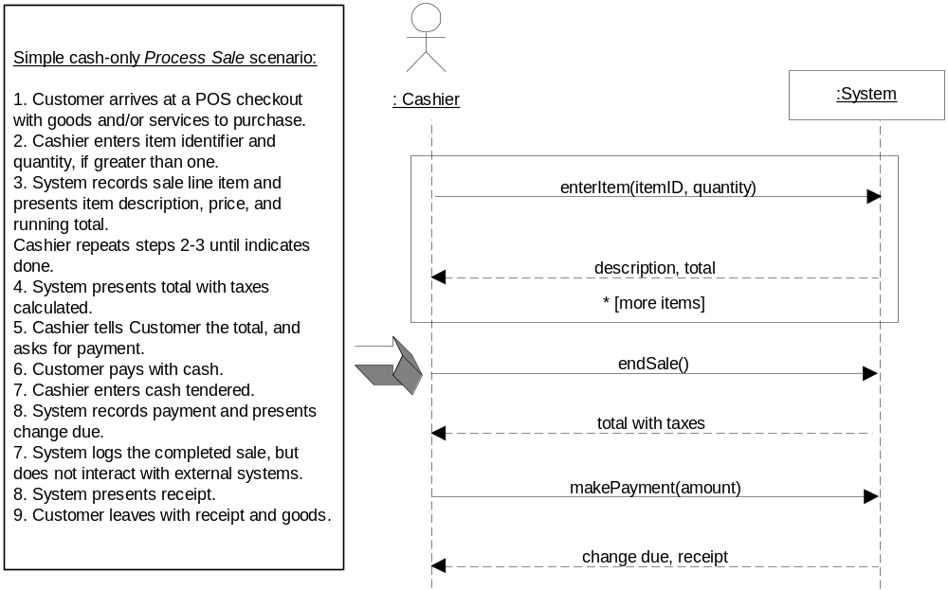
Sequence diagram derived from use-case
W5L1 Operations and Contracts
COMP 3831 OOA&D

Slide 5
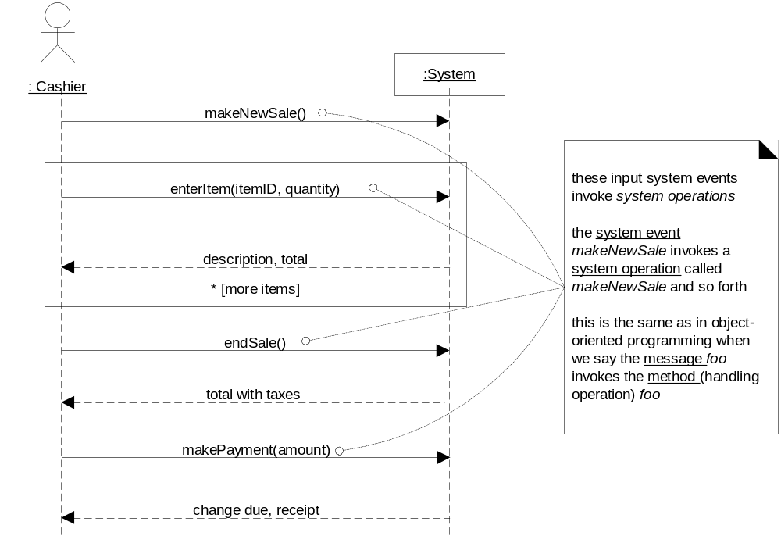
System operations handling input events
W5L1 Operations and Contracts
COMP 3831 OOA&D

Slide 6
Example Contract: enterItem
Operation: | enterItem(itemID : ItemID, quantity : integer)
Cross References: | Use Cases: Process Sale
Preconditions: | There is a sale underway.
Postconditions: | A SalesLineItem instance sli was created (instance creation) sli was associated with the current Sale (association formed) sli.quantity became quantity (attribute modification) sli was associated with a ProductSpecification, based on itemID match (association formed)
W5L1 Operations and Contracts
COMP 3831 OOA&D

Slide 7
Contract sections
Operation: | Name of operation and parameters
Cross References: | (optional) Use cases this operation can occur within
Preconditions: | Noteworthy assumptions about the state of the system or objects in the Domain Model before execution of the operation. These will not be tested within the logic of this operation, are assumed to be true, and are non-trivial assumptions the reader should know were made.
Postconditions: | The state of objects in the Domain Model after completion of the operation. Discussed in detail later ….
W5L1 Operations and Contracts
COMP 3831 OOA&D

Slide 8
Postconditions
Changes in the state of objects in the Domain Model, which include:
  Instances created and deleted
  Associations (UML links) formed and broken
  Attributes modification
Declarations about Domain Model objects that are true when the operation has finished – after the smoke has cleared.
Expressed in a declarative fashion …
W5L1 Operations and Contracts
COMP 3831 OOA&D

Slide 9
Examples of broken associations
When a loan is paid off …
When someone cancels their membership in a club
A country’s law stipulates that seven years after a person has declared bankruptcy, all records of their bankruptcy declaration must be destroyed.
ClassA
ClassB
W5L1 Operations and Contracts
COMP 3831 OOA&D

Slide 10
Postcondition pitfalls
Describes state changes required of a system and not how they are going to be achieved.
Focus analytically on what must happen, and not how it is to be accomplished
Unnecessary and undesirable to be overly verbose and detailed
Express postconditions in the past tense:
  <Better> ➔ A SaleLineItem was created
  <Worse> ➔ Create a SalesLineItem
W5L1 Operations and Contracts
COMP 3831 OOA&D

Slide 11
Contract evolution
Start with an initial best guess. Incomplete is better than deferring investigation
Generating a complete detailed set of postconditions for system operation in not necessary during initial requirements work
Fine details (or perhaps larger ones) will be discovered later during design work
It is all about iterative development: discoveries during previous iteration enhances investigation and analysis of following iteration
W5L1 Operations and Contracts
COMP 3831 OOA&D

Slide 12
Contracts & Domain Model updates
It is common that during creation of contracts you discover need to record new conceptual classes, attributes, or associations in the Domain Model
Enhance your Domain Model as you make new discoveries while thinking through contracts.
W5L1 Operations and Contracts
COMP 3831 OOA&D

Slide 13
Contracts vs. Use Cases
Contracts may not be needed if use cases provide most or all of the detail necessary for design
Contracts, on the other hand, are handy where details and complexity of required state changes are awkward to capture in use cases
W5L1 Operations and Contracts
COMP 3831 OOA&D

Slide 14
Contract pitfalls
Do not make contracts for every system operation of every use case
If you find yourself creating too many contracts, then project may be suffering from the following ailments:
  Use cases are poorly done
  Not enough ongoing collaboration or access to a subject matter expert
  Your team is doing too much unnecessary documentation
W5L1 Operations and Contracts
COMP 3831 OOA&D

Slide 15
Contract pitfalls (continued …)
Remember to establish a memory between existing objects and those newly created by defining the forming of an association
Postconditions: | A SalesLineItem instance sli was created (instance creation) sli was associated with the current Sale (association formed) sli.quantity became quantity (attribute modification) sli was associated with a ProductSpecification, based on itemID match (association formed)
It is necessary to define the
forming of a new association
W5L1 Operations and Contracts
COMP 3831 OOA&D

Slide 16
Contracts: guidelines
To write contracts:
Identify system operations from the SSDs (system sequence diagrams)
Construct contracts for operations that are complex, subtle in their results, or not clear in the use case
Use following categories to describe postconditions:
  Instance creation and deletion
  Attribute modification
  Associations formed and broken
W5L1 Operations and Contracts
COMP 3831 OOA&D

Slide 17
POS example
Contract C01: makeNewSale
Operation: | makeNewSale()
Cross References: | Use Cases: Process Sale
Preconditions: | none
Postconditions: | A Sale instance s was created (instance creation) s was associated with the Register (association formed) Attributes of s were initialized
Contract C02: enterItem
Operation: | enterItem(itemID : ItemID, quantity : integer)
Cross References: | Use Cases: Process Sale
Preconditions: | There is a sale underway.
Postconditions: | A SalesLineItem instance sli was created (instance creation) sli was associated with the current Sale (association formed) sli.quantity became quantity (attribute modification) sli was associated with a ProductSpecification, based on itemID match (association formed)
W5L1 Operations and Contracts
COMP 3831 OOA&D

Slide 18
POS example
Contract C03: endSale
Operation: | endSale()
Cross References: | Use Cases: Process Sale
Preconditions: | There is a sale underway
Postconditions: | Sale.isComplete became true (attribute modification)
Data item suggested in contract that is not yet represented in domain model
Sale
isComplete : Boolean
Date
time
W5L1 Operations and Contracts
COMP 3831 OOA&D

Slide 19
Operations in the eyes of UML
An operation is a specification of a transformation or query that an object may be called to execute.
  Example: elements of an interface are operations
An operation is an abstraction, not an implementation.
  By contrast, a method (in the UML) is an implementation of an operation
A UML operation has a signature (name & parameters) and an operation specification (postconditions)
W5L1 Operations and Contracts
COMP 3831 OOA&D

Slide 20
UP Phases and Contracts
Inception – contracts are not motivated during inception because they are too detailed
Elaboration – If used at all, most contracts will be written during elaboration
W5L1 Operations and Contracts
COMP 3831 OOA&D

Slide 21
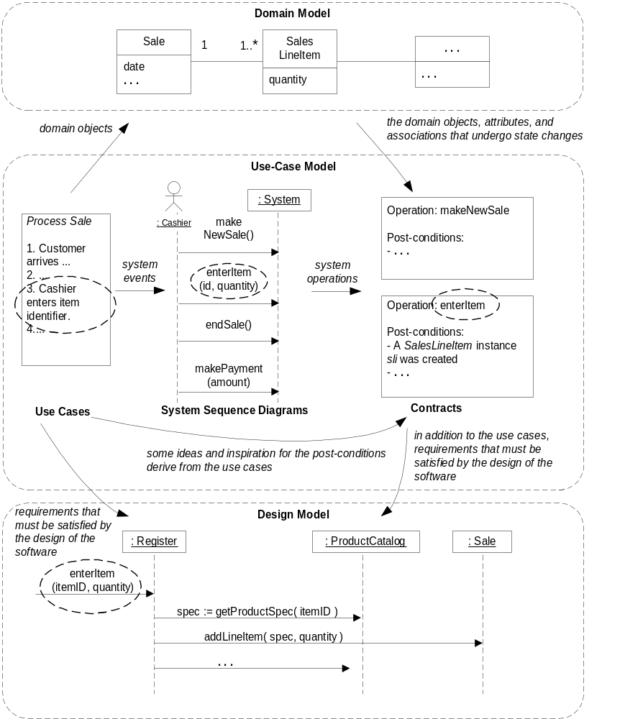
Contract relationship to other artifacts
W5L1 Operations and Contracts
COMP 3831 OOA&D

Slide 22
Questions
W5L1 Operations and Contracts
COMP 3831 OOA&D

Slide 23
Requirements to Design - Iteratively
Inception
Elaboration
Construction
Transition
COMP 3831
Larman: Chapter 12
W5L1 Operations and Contracts
COMP 3831 OOA&D

Slide 24
Requirements and OOA
Focused on learning to do the right thing
  understand the goals and related rules and constraints
Design stresses do the thing right
In iterative development, a transition from requirements to design will occur in each iteration
By the end of elaboration, ~80% of the requirements are reliably defined in detail.
W5L1 Operations and Contracts
COMP 3831 OOA&D

Slide 25
Object Design
It is here that a logical O-O solution is developed.
Interaction Diagrams are a key artifact.
  illustrate how objects collaborate to fulfill requirements
Class Diagrams may also be used
These artifacts help to make up the Design Model
W5L1 Operations and Contracts
COMP 3831 OOA&D

Slide 26
Object Design Skill Vs. UML Notation Skill
What is important is knowing how to think and design in objects
This is quite a different skill, and much more important skill than knowing UML diagramming notation
Object design requires knowledge of:
  principles of responsibility assignment
  design patterns
W5L1 Operations and Contracts
COMP 3831 OOA&D

Slide 27
Questions and Conclusions
W5L1 Operations and Contracts
COMP 3831 OOA&D

